Slide 1


Logical Vision:
Meta-Interpretive Learning for Simple Geometrical Concepts
Wang-Zhou Dai
Stephen H. Muggleton
Zhi-Hua Zhou
Notes:
Good afternoon every one, my name is Wang-Zhou Dai, I’m from Nanjing University, I will give a talk about how to learn simple visual concepts by ILP. This is a joint work with Prof. Stephen Muggleton.

Slide 2
Outline
Motivation
Proposed Method
Experiments
Notes:
First I will talk about our motivation.

Slide 3
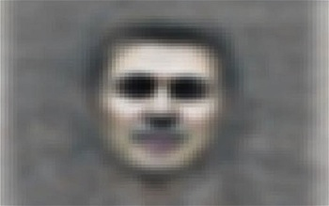
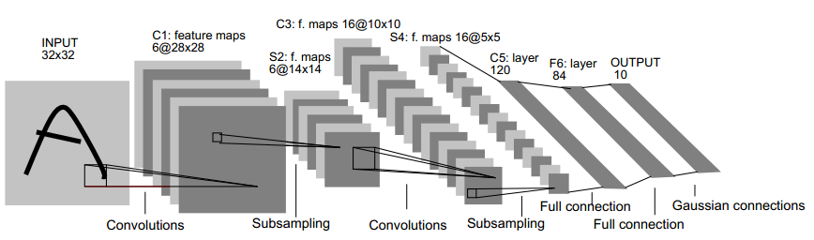
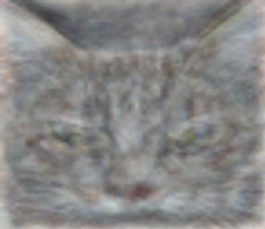
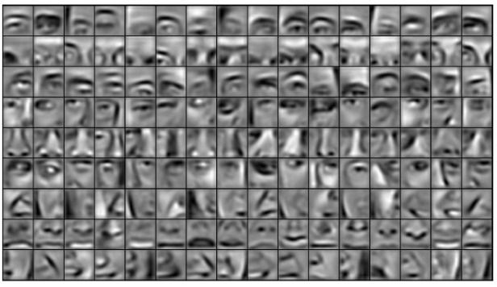
Motivation
Great success of statistical learning in computer vision
Notes:
For many years, statistical learning has dominated Computer vision area, especially in recent years, Deep Learning achieves a near-human performance. They are promising because they are able to learn high-level representation of some visual concepts, such as faces of human and even cats.

Slide 4
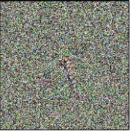



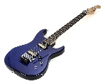

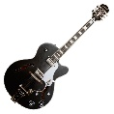
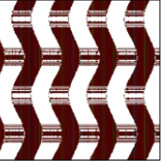
Critics
High-confidence on unrecognizable pictures [Ahn, N., et.al., 2015]
classification hyperplane
Far from real pictures (high confidence)
Notes:
However, there are some critics on statistical computer vision especially DNNs in last few years. For example, people can trick the system by using some artificially produced images which are totally unrecognizable, while these systems will return a high confidence that they are images of real objects. The author pointed out that the main problem is that the statistical learning only learns a classification hyperplane that split the feature space, in which the real images are actually clustered in a small area, however, the unrecognizable images that lies far from the real images are positioned deeply inside the classification area, which induces a large confidence.

Slide 5
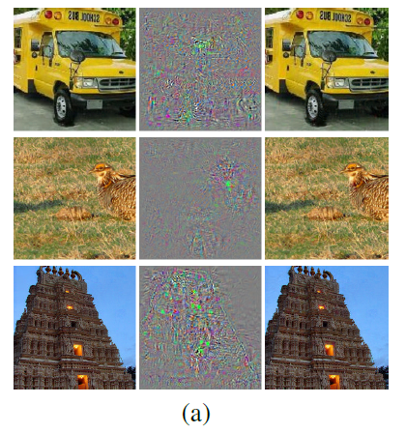
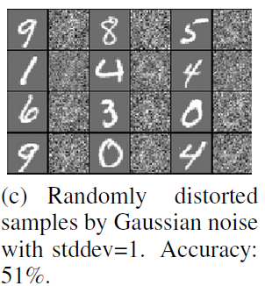
Critics (cont’ d)
Sensitive to small perturbations [Szegedy, C., et.al., 2013]
Notes:
Another problem is that one can add some human-unrecognizable noise to the images, and trick the classifiers again to make them believe an original correctly classified image to be unrecognizable. Which means the systems are very sensitive to small changes in low-level feature space.

Slide 6

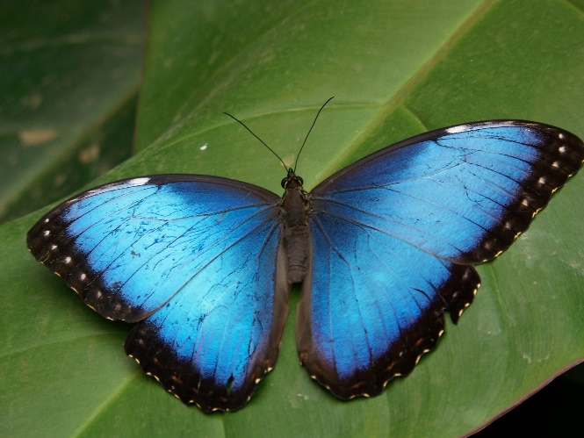
Motivation
Can we learn visual concepts symbolically and constructively?
Our idea:
Extract mid-level features (symbols).
Learn target concept with the symbols through ILP.
Totally different pixels (low-level features)
Same semantics
  Same components (symbols)
  Same structure (symbols)
  …
Notes:
Now look at the two images, the low-level features are totally different, however, human being can label them as same object – butterfly. This is because human being recognize objects constructively. We know that these two objects all have big wings attached to a small body, so they are likely to be a butterfly. Even a child do not know what is a butterfly could understand that they are likely to be same thing.

Slide 7
Outline
Motivation
Proposed Method
Experiments
Notes:
Now I will introduce our framework and implementation quickly.

Slide 8
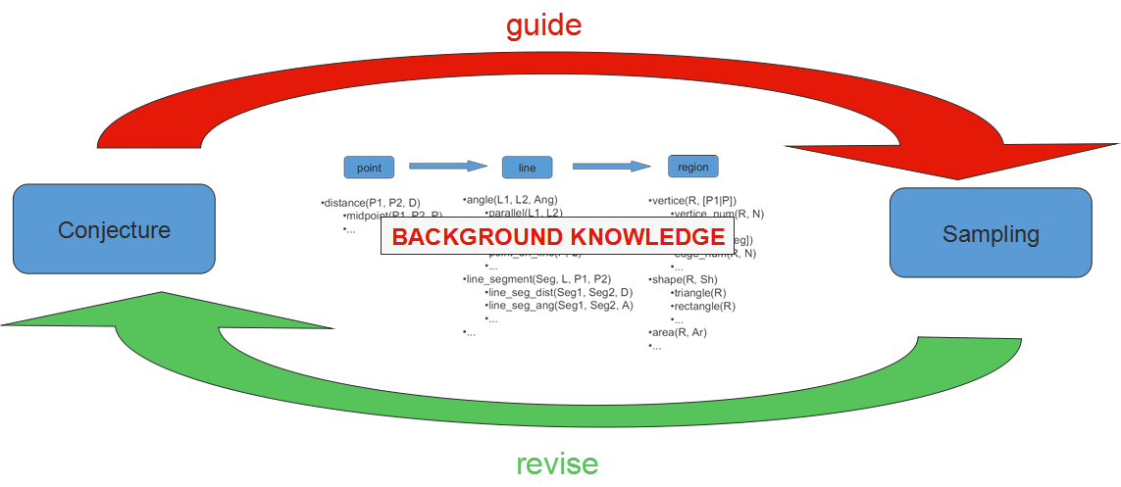
Proposed Method
Symbol extraction
Notes:
At first, we use prolog to extract mid-level features, which are symbols, from images. With certain background knowledge, we repeatedly performance sampling low-level features and make symbolic conjectures. And the conjectures we obtained will guide the procedure of sampling, the sampling of low-level features will help us revise our conjectures.

Slide 9

Proposed Method
Polygon extraction
% Primitives
% Use N to limit recursion times (precision)
edge_line_seg(P1, P2, 0):-
edge_point(P1),
edge_point(P2),
midpoint(P1, P2, P),
edge_point(P).
edge_line_seg(P1, P2, N):-
midpoint(P1, P2, P),
edge_line_seg(P1, P, N - 1),
edge_line_seg(P, P2, N - 1).
% Communication with pixels (low-level feature, only thing realized without prolog)
edge_point(P):-
P's (color) gradient >= threshold.
pol(Name, [Edge1, Edge2,…]).
Edge = [Start, End].
Notes:
Here is an example of extracting a polygon. The background knowledge is definition of line segment, and a sampling predicate that returns whether a pixel’s color gradient exceeds a given threshold, which is assumed to be a point on an edge of a polygon. First we do sampling, then we make a conjecture that there exists an edge between these to points, then we sample another point to examine whether our conjecture is correct. If failed, we will do more sampling and revise the previous conjectures. In this example, the examination is only performed once, which means it only checks whether the midpoint of our edge conjecture has a large color gradient. If we increase the number of points to be sampled in the examination, it is possible to learn the zigzag border.
At last, a polygon is represented as a list of all its edges, and an edge is a list of its end points.

Slide 10
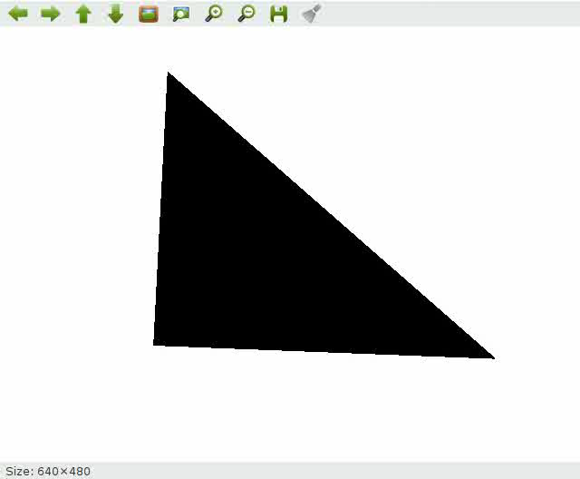
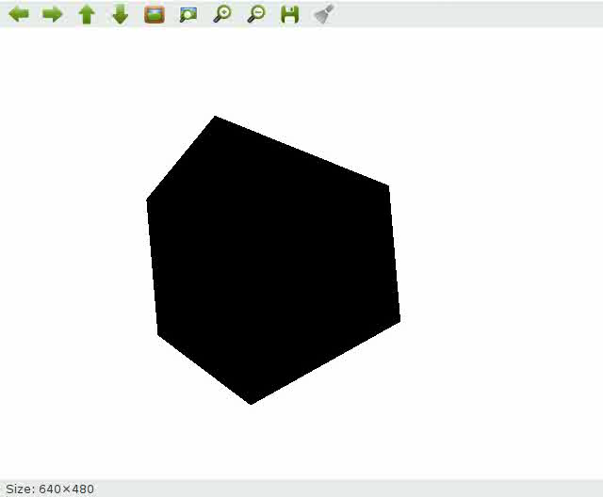
Proposed Method
Extracting polygons
Notes:
Here are two examples of extracting polygons that realized by our system. Except for the display module and color gradient checking predicate, all the program are programmed by prolog.

Slide 11
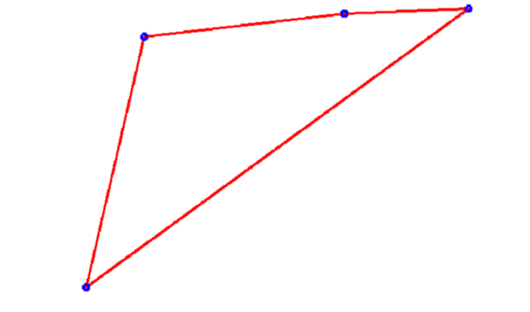
Proposed Method
Meta-interpretive learning [Muggleton, et.al., 2015]
  Use meta-rules to abduce the induction
    Predicate invention
    Learning recursions
    …
  Background knowledge
    edge_length/2, list_length/2,
    angle_list/2, std_dev_bounded/2,
    …
  Deal with noises
    connect_edges(Pol1, Pol2, Thresh)
    Do symbol extraction multiple times
Notes:
Then we use MIL two learn the definition of shapes based on the polygons we just have extracted. Because it can perform predicate invention and learn recursions, which is quite useful for learning visual concepts.
The background knowledge are length of edges, length of a list, computing the angles of a polygon, and computing standard deviation, and so on.
During the sampling procedure, noise always occurs, so we do multiple times symbol extraction and include another predicate as background knowledge, which can remove redundant vertices by learning a threshold of its angle.

Slide 12
Outline
Motivation
Proposed Method
Experiments
Notes:
Now I will introduce our experiments

Slide 13
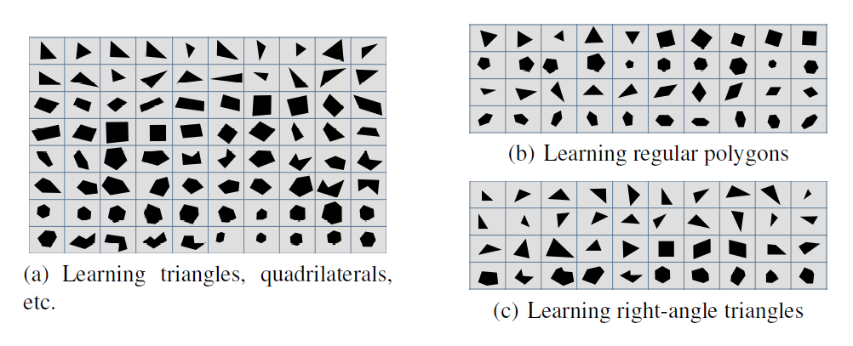
Experiments
3 tasks
6 predicates:
  triangle/1, quadrilateral/1, pentagon/1, hexagon/1, regular_polygon/1, right_angle_triangle/1.
Notes:
The task is to learn shapes, we grouped them into 3 databases: the first one learns the number of edges, like …, the second one learns the notion of regular polygon, the third learns the concept of right angle triangles, which uses the logic program we learned in the first task.

Slide 14
Experiments
Compared methods
  Vlfeat [Vedaldi, A., Fulkerson, B., 2008]
    PHOW (dense SIFT) feature
    SVM learner
  LogicalVision (Proposed method)
    Extract polygon 5 times for an image
Notes:
Comparisons are between the Vlfeat and our method, Vlfeat is a very popular vision tool box, we used a kind of SIFT feature and SVM classifier for it. All the parameter including the size of feature space are selected by cross-validation.
To deal with noise, LogicalVision did 5 times of polygon extraction for each image.

Slide 15
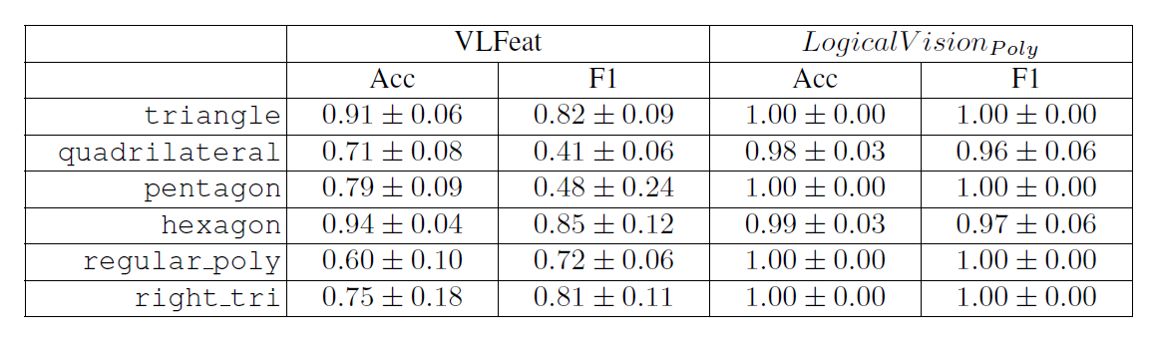
Experiments
Results
Notes:
This is the result of our experiments, you can see that by using symbolic representation, the performance is much better than learning directly from a low-level feature space. Especially in difficult tasks like learning regular polygons.

Slide 16
Experiments
Results
triangle_1(A,C,H):-connect_edges(A,B,C),list_length(B,H)
triangle_0(A,A2,B2):-polygon(A,B),triangle_1(B,A2,B2)
triangle(A):-triangle_0(A,0.04,3)
triangle_0(A,G):-polygon(A,B),list_length(B,G)
triangle(A):-triangle_0(A,3)
regular_poly_1(A,G):-angles_list(A,B),std_dev_bounded(B,G).
regular_poly_0(A,A2):-polygon(A,B),regular_poly_1(B,A2).
regular_poly(A):-regular_poly_0(A,0.02).
right_angle_2(A,G,H):-angles_list(A,B),has_angle(B,G,H)
right_angle_1(A,A2,B2):-polygon(A,B),right_angle_2(B,A2,B2)
right_angle_0(A,A2,B2):-right_angle_1(A,A2,B2),triangle(A)
right_angle(A):-right_angle_0(A,0.5,0.015)
Notes:
These are learned programs in some episodes, you can see that the semantics of the shapes are quite clear and correct. For example…

Slide 17
Q&A
Thanks!

