Slide 1
In Silico Screening of Zinc (II) Enzyme Inhibitors Using ILP
Tadasuke Ito, Shotaro Togami, Shin Aoki and Hayato Ohwada
Department of Industrial Administration
Tokyo University of Science
Notes:
Thank you, chairman.
My name is Tadasuke Ito.
I am a second graduate student at Tokyo university of science.
Today, I'd like to talk about "In Silico Screening of Zinc Enzyme Inhibitors Using ILP".

Slide 2
Introduction 1/4
In-silico screening is a powerful, low-cost method of
finding strong binders for proteins and enzymes
・Structure-Based Virtual Screening (SBVS)
⇒ Docking Simulation
・Ligand-Based Virtual Screening (LBVS)
⇒ Machine Learning
(FingerPrint, Chemical Descriptor, …)
Notes:
As you know, there are many drug discovery works referred to as in silico, for example Structure-Based Virtual Screening.
Docking Simulation is one of the SBVS method.
This method needs compound structure and protein 3D structure.
If an enzyme structure is unknown, it cannot be applied to SBVS.
An alternative way to screen ligands is Ligand-Based Virtual Screening(LBVS).
This method predicts inhibitor by structural similarity of known ligands.
LBVS such as Machine Learning doesn’t require protein 3D structure.
We focus on machine learning method.

Slide 3

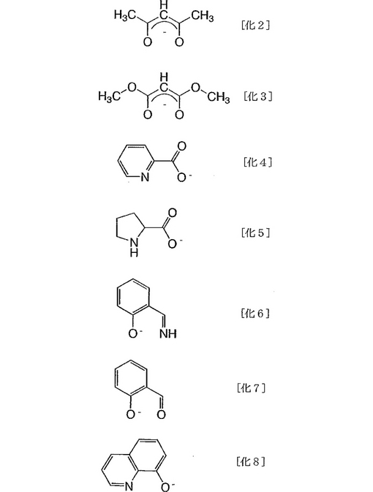




Introduction 2/4
・ Machine Learning Method
Inhibitor candidates
・Machine Learning
・Inhibitor DataBase
Result
ligand
decoy
classification
model
SVM, RandomForest, …
ILP
Notes:
machine learning makes classification model using Database.
In most cases, a discrimination model is a black box.
However, ILP can visually express the common rule of ligands.
Obtaining a clear classification model is important for drug-discovery researchers.

Slide 4
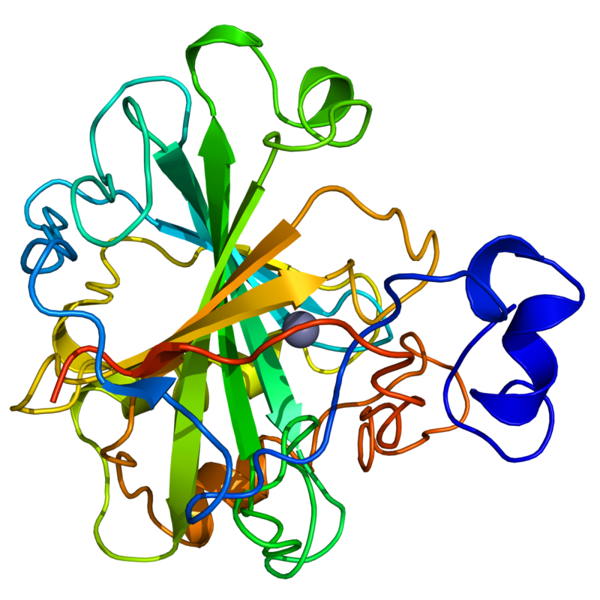
Introduction 3/4
Carbonic anhydrase II (CAH2)
CAH2 contain zinc.
Catalytic reaction :
CAH2
CA inhibitors
・Epilepsy
Remedy
・Glaucoma
Notes:
This study, target enzyme is carbonic anhydrase2.
CAH2 contain zinc.
This enzyme catalyzes hydration of carbon dioxide.
This chemical reaction in the body is important.
In addition, CAH2 inhibitors have been used to treat epilepsy and glaucoma.
Therefore CAH2 is important target.

Slide 5
Introduction 4/4
Drug-discovery researchers expects
high classification performance for inhibitors
clear classification model
Our objective is screening many inhibitor candidates of CAH2
high classification performance
Classifier provides
graphical classification model
Notes:
On the basis of these considerations, our objective is screening of CAH2 with high classification performance and getting graphical classification model.
Therefore, we adopt the ILP.

Slide 6


Method 1/4
Data Extraction
Database
Obtain ligands and decoys
actives_final.mo2
⇒Ligand(inhibitor)
decoys_final.mol2
⇒Decoy(non-inhibitor)
Database of Useful
Decoys: Enhanced
(DUD-E)
Number of CA inhibitors
Training data
Notes:
Next, I will talk about ILP method.
First, we obtain ligands and decoys from DUD-E.
Ligand is the inhibitor.
Decoy is the non-inhibitor.
The ligands and decoys have been clustered.
In each cluster, these have the same structure but different charges.
Therefore, we performed our experiment using this cluster.
In addition, we reduced the number of decoys in order to avoid over-fitting and shorten computing time.

Slide 7

Method 2/4
Machine learning with ILP
actives_final.mo2
decoys_final.mo2
ILP system : GKS
Input data : CompoundStructure
Extraction
Class
Positive ⇒ Ligand(actives_final.mo2)
Negative ⇒ Decoy(decoys_final.mo2)
Clauses(Input)
・bond(compound, atomid, atomid, bondtype)
・atom(compound, atomid, atomtype)
・ring(compound, ringid, atomid, ringsize)
Rule(Output)
bond(A, B, C, 2), atom(A, B, cl), ring(A, D, B, 6)
Notes:
Second, It is necessary to convert the Mol2files to the ILP format.
Our method uses these statements.
Bond() is a description of the bonding between atoms.
Atom() is a description of types of atoms.
Ring() is a description of the atoms contained in a cyclic compound.
ILP creates a rule that applies only to ligands using a combination of these statements.

Slide 8
Method 3/4
training data
make rules
bond(A, B, C, 2), atom(A, B, cl), ring(A, D, B, 6)
applies to rules
test data
Compound 1
Compound 2
Compound 3
….
Compound n
If the compound applies to rules,
the predicted value is 1.
If not, the predicted value is 0.
※1 : ligand, 0 : decoy
ligand or decoy?
Notes:
ILP learns training data and outputs rules.
Then, we apply the rules to the each compound in test data.
If at least one rule covers the compound, a number “1” is assigned.
Conversely, if all outputted rules do not cover the compound, a number “0” is assigned.

Slide 9
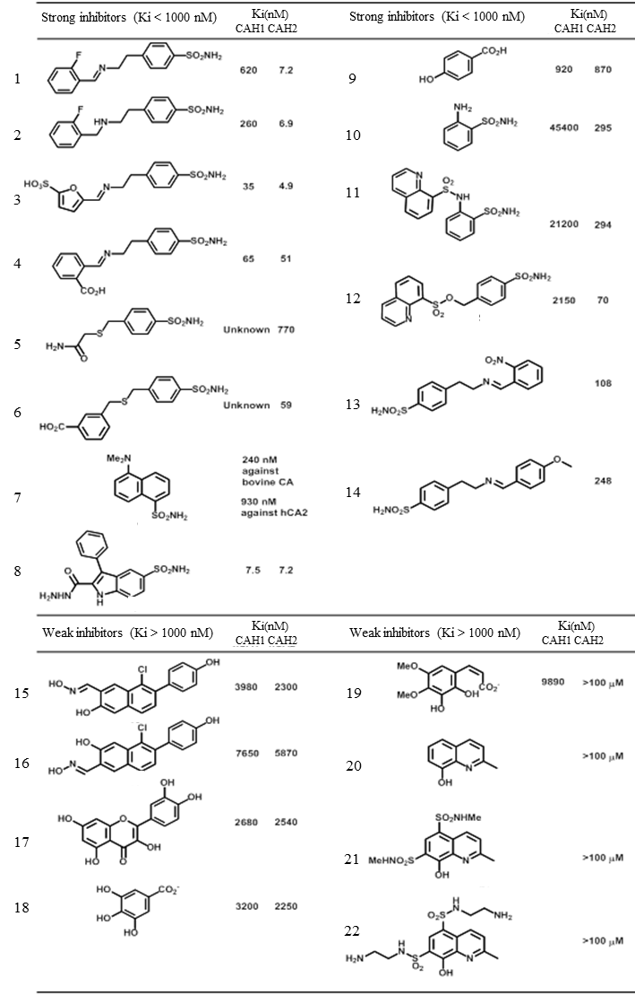
Method 4/4
Evaluation method
Ligand : 14
Decoy : 8
22 inhibitor candidates that are not included in DUD-E
Notes:
We evaluate the performance of machine-learning methods by inhibitor candidates that are not included in DUD-E.
We prepare 22 inhibitor candidates.
these are obtained from the literature, or are designed and synthesized.

Slide 10
Results 1/4
Classification result
Data set
training data : ligands = 492, decoys = 3000
test data : ligands = 14, decoys = 8
Parameters
depth = 10, negative = 10, positive = 10, clause_size = 6
Output
11 rules
Notes:
This table shows classification result of ILP.
ILP can classify ligands and decoys with excellent accuracy.
The dataset from DUD-E is imbalanced.
Becouse the number of decoys is very high.
However, The F1 score is almost 0.9.

Slide 11
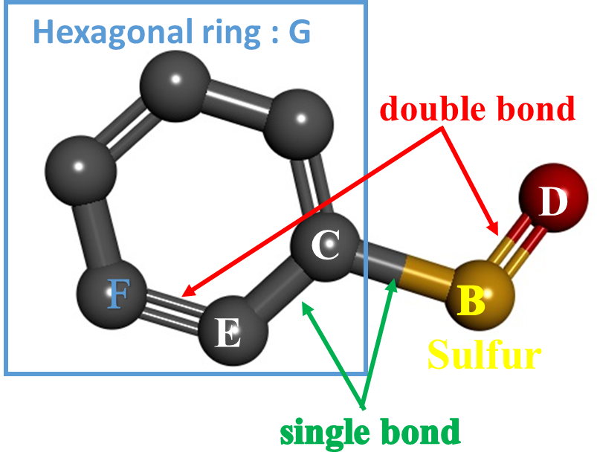
Results 2/4
Rule 2
dock(A) :- atom(A, B, s), bond(A, C, B, 1), bond(A, B, D, 2), dock(A) :- bond(A, C, E, 1), bond(A, E, F, 2), ring(A, G, F, 6)
Score
Training data
Positive : 125 / 492
Negative : 8 / 3000
Test data
Positive : 12 / 14
Negative : 2 / 8
Notes:
Next, I will explain rules that were derived by ILP.
rule2 has high ligand coverage in the training data.
In addition, most ligands in the test data are detected by rules 2.

Slide 12
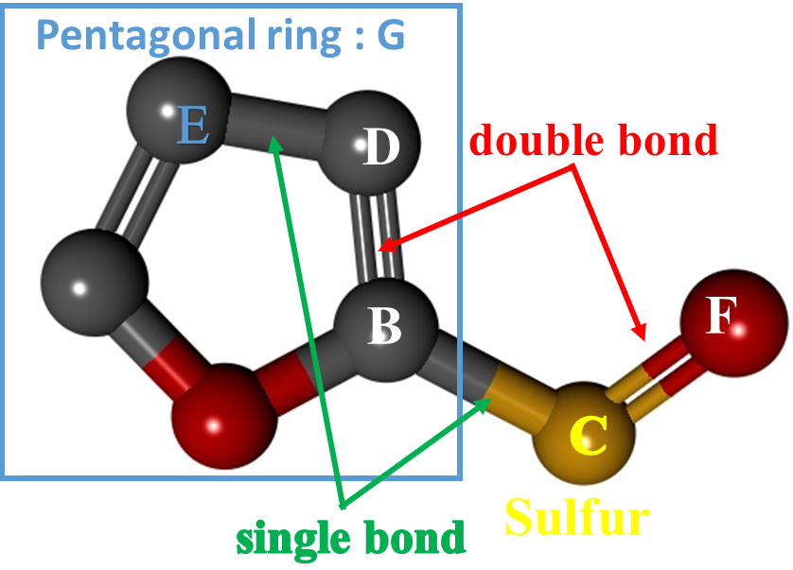
Results 3/4
Rule 1
dock(A) :- bond(A, B, C, 1), atom(A, C, s), bond(A, D, B, 2),
dock(A) :- bond(A, E, D, 1), bond(A, C, F, 2), ring(A, G, E, 5)
Score
Training data
Positive : 118 / 492
Negative : 7 / 3000
Test data
Positive : 1 / 14
Negative : 0 / 8
Notes:
Rule 1 is very similar to rule 2.
hexagonal ring are replaced by pentagonal ring.
rule1 has high ligand coverage in the training data.
But, few ligands are covered by rule 1 in the test data.
Because, the small number of pentagonal rings in the test data.

Slide 13
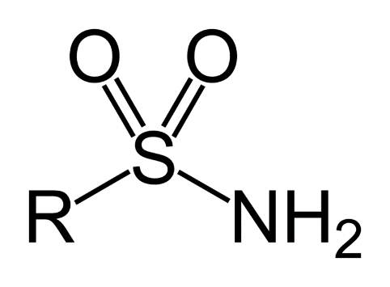
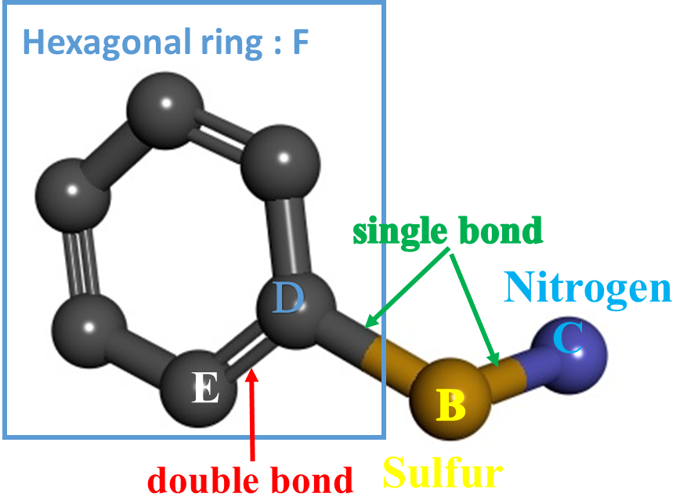
Results 4/4
Rule 4
dock(A) :- bond(A, B, C, 1), atom(A, B, s), atom(A, C, n), dock(A) :- bond(A, D, B, 1), bond(A, D, E, 2), ring(A, F, D, 6)
Score
Training data
Positive : 191 / 492
Negative : 10 / 3000
Test data
Positive : 1 / 14
Negative : 0 / 8
sulfonamide
Notes:
rule4 has high ligand coverage in the training data.
This rule contains nitrogen atom that are not included in rule2.
Contrary to rule2, rule4 cover only one ligand in the test data.
However, other rules can’t detect this ligand.
Most known cah2 inhibitor has sulfonamide.
This rule is similar to sulfonamide.
on the other hand, all rules contain sulfur atom.
Therefore the ligand of CAH2 is affected by the sulfur atom.

Slide 14
Conclusion
Method
Machine Learning : Inductive Logic Programming (ILP)
Database : Database of Useful Decoys: Enhanced (DUD-E)
Target enzymes : Carbonic anhydrase II
Classified new inhibitor candidates (14 ligands, 8 decoys)
predicts ligand high performance
provides a clear classification model
Our method could be applied to other zinc enzymes.
angiotensin-converting enzyme, histone deacetylase, metallo-B-lactamase, …
Notes:
Let me summarize the point of my presentation.
Drug-discovery researchers expects high classification performance for inhibitors and clear classification model.
Therefore, we use ILP classification method.
ILP classify ligands and decoys with excellent accuracy and provides a clear classification model.
Our method could be applied to other zinc enzymes.
Thank you for your kind attention.
I am happy to answer any question that you might have.

