Slide 1
Extracting the Common Structure of Compounds to Induce Plant Immunity Activation using ILP
20/08/2015
Department of Industrial Administration, Faculty of Science and Technology,
Tokyo University of Science
Presenter: Atsushi Matsumoto

Slide 2

Introduction
１
Pest
Pathogen
Using fungicides and pesticides
Decreased production of agricultural crops

Slide 3
Introduction
２
increasing the immunity of the plant
by plant immunity activator
Disadvantages of using fungicides and pesticides
・destruction of biota
・health damage in humans
・emergence of resistant pathogen

Slide 4
Why is machine learning used?
３
・the kind of compounds
used in the experiments is enormous
→ the time required and the high cost of
screening compounds
→ Efficiency of the screening by using
machine learning

Slide 5
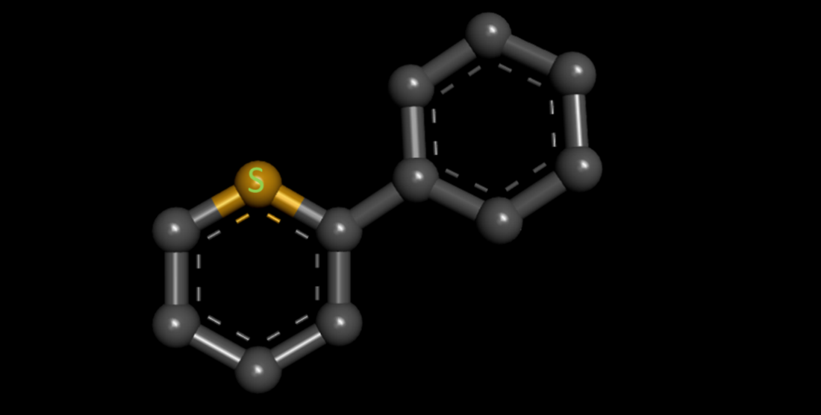
Objective
４
Extracting the Common Structure of Compounds to Induce Plant Immunity Activation
an example of Common Structure

Slide 6
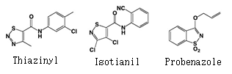
Plant immunity
５
Plant immunity
A defense system to protect plants
from various enemies
Plant immunity activator
A drug that activates plant immunity
Known plant-immunity activators

Slide 7
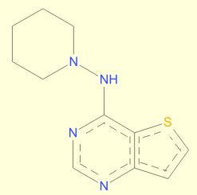

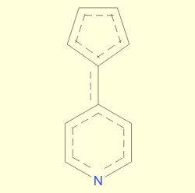
Process
６
Input
compounds data
Extraction
1.Structural features
(e.g. atom , bond)
2.Other features
(e.g. Hydrophobicity)
Transformation
Output
GKS
(ILP system)
Structure data
1.Background knowledge
(compound features
expressed by the predicate)
2.Positive or Negative
Learning

Slide 8
Predicate
７
Predicate List
Select several predicates as background knowledge

Slide 9
Dataset
８
・ROS(reactive oxygen species)
If the ROS value is high,
the compound is likely to be a plant-immunity activator
Positive
Negative
High ROS compounds
Low ROS compounds

Slide 10
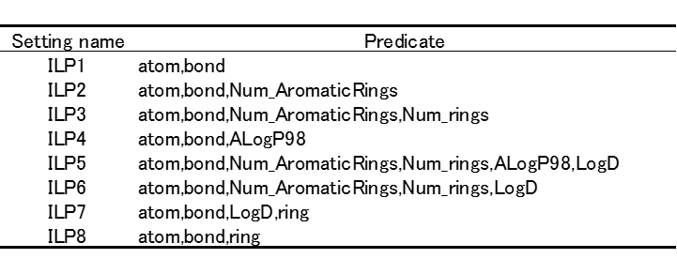
Experiment
９
①ILP
Select several predicates as background knowledge
②SVM(To compare with ILP)
Using 77 features for learning

Slide 11
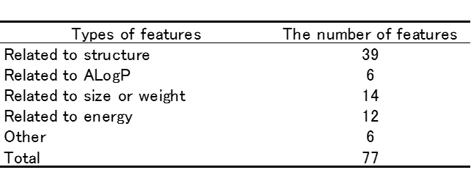
SVM
Attributes used for SVM

Slide 12
Result
１０
①ILP
②SVM(To compare with ILP)

Slide 13
Examples of the Common Structures
１１
Rules
Rule2
Rule2
Rule1,2,5
Known plant-immunity activators

Slide 14
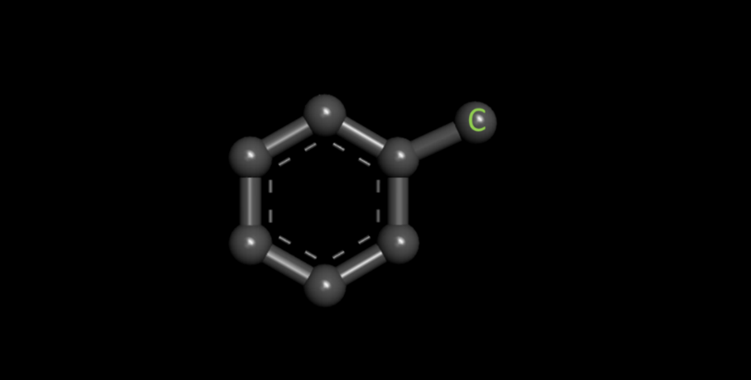
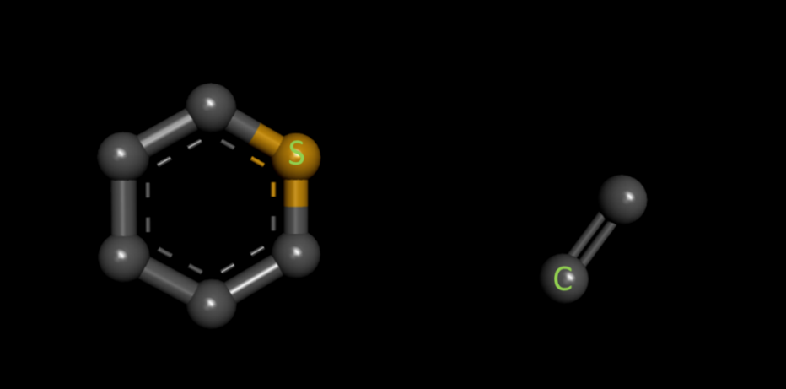
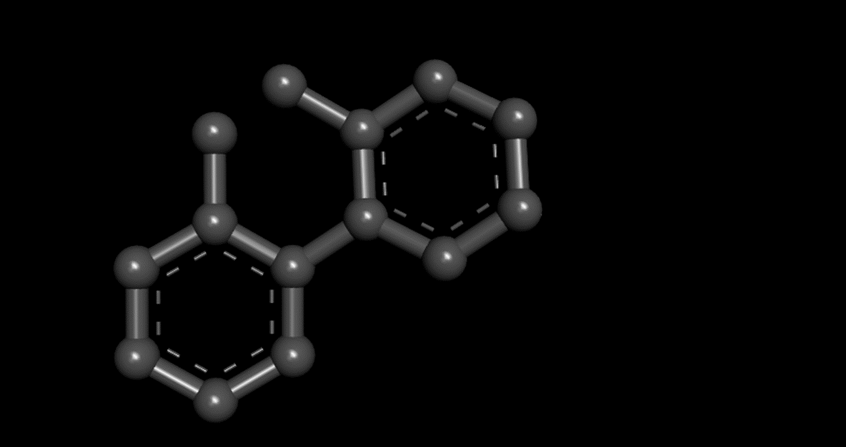
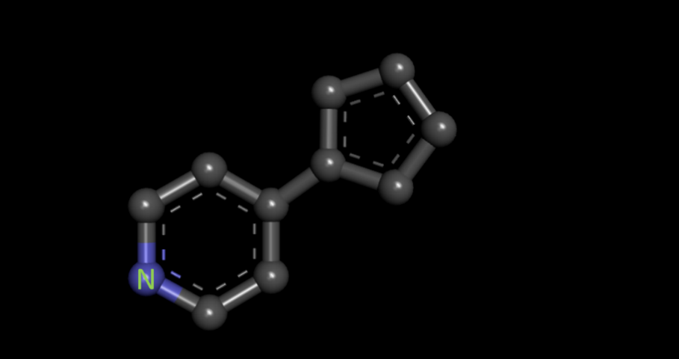

Examples of the Common Structures
１２
Rule1
Rule2
＋
Rule3
Rule4
Rule5

Slide 15
Conclusion
１３
・Extracting the Common Structure of Compounds to Induce Plant Immunity Activation
・Although SVM F values slightly exceeded those of ILP, ILP tp values greatly exceeded those of SVM
・Some rules were included in known compounds structure
・As for other rules, there is a need for further investigation

Slide 16
Future work
１４
・In order to improve prediction accuracy, it is essential to improve background knowledge.
(e.g. Add some functional groups to predicates)
・In this study, it was a two-class classification.
However, the ROS value is not a discrete value.
It is necessary to change the threshold and the number of class.

Slide 17
biota
Concept that summarizes all of the organisms that live in a particular environment
emergence of resistant pathogen
Long-term use of the fungicide

Slide 18
screening
To find those which show the efficacy-activity from a large number of compounds
Hydrophobicity
Not easily mix with water

Slide 19
Plant immunity activator
As far as my research there are only three compounds
Why we focus on the tp value
We think discovery positive is more important than accuracy

Slide 20
ILP setting
Positive limit 10
Negative limit 10
Length of clause 6
Plant immunity system
the mechanism of
plant-immunity activation is still largely unknown

